Slide 1
SELF CARE JOURNAL
GROUP NUMBER 16
SUBMITTED BY:-
KHUSHI GUPTA-2210990512
KASHVI SHARMA-2210990499
KESHAV WADHWA-2210990506
NISHTHA TANDON-2210990621

Slide 2
Index
Introduction
Objective
Tools & Technologies
Code Snapshots
Result
Conclusion
References

Slide 3

Introduction

Slide 4
.
Self-care is the practice of deliberately taking steps to maintain or improve one's physical, mental, and emotional well-being.
In today's fast-paced world, self-care is increasingly recognized as essential for overall health and resilience.
It encompasses a wide range of activities, from basic self-care tasks like eating well and getting enough sleep, to activities that nourish the mind and soul like meditation and spending time in nature.

Slide 5
.
Self-care is not selfish; it's about recognizing your own needs and prioritizing your health and happiness.
By practicing self-care, you can reduce stress, increase resilience, and enhance your overall quality of life.
Self care will give you a new and a much healthier lifestyle to live

Slide 6

Objective

Slide 7
.
Promoting Health and Well-being: The primary objective of self-care is to promote and maintain optimal physical, mental, and emotional health. This includes engaging in activities such as regular exercise, balanced nutrition, adequate sleep etc.
Preventing Illness and Disease: Self-care aims to prevent the onset of illness and disease by adopting healthy lifestyle behaviors and implementing preventive measures.
Managing Chronic Conditions: For individuals living with chronic health conditions, self-care plays a crucial role in managing symptoms, minimizing complications, and improving quality of life.

Slide 8
.
Enhancing Quality of Life: Self-care seeks to enhance overall quality of life by empowering individuals to take an active role in their health management and decision-making.
Promoting Self-awareness and Self-efficacy: Engaging in self-care fosters self-awareness and self-efficacy—the belief in one's ability to successfully manage one's health and well-being.
Empowering Individuals: Self-care empowers individuals to take control of their health and become active participants in their own care.

Slide 9
Tools & Technologies
HTML: HTML, Hypertext Markup Language, serves as the backbone of web development, providing the structure and content of web pages. Through a system of tags and attributes, HTML defines elements such as headings, paragraphs, images, links, and more.
CSS: CSS, or Cascading Style Sheets, complements HTML by defining the presentation and layout of web pages. With CSS, developers can control the appearance of HTML elements, including colors, fonts, spacing, and positioning, across different devices and screen sizes.

Slide 10
.
JavaScript: JavaScript, often abbreviated as JS, is a versatile programming language primarily used for adding interactivity and dynamic behavior to web pages. It enables developers to manipulate HTML elements, handle user interactions, and communicate with web servers asynchronously, enhancing the functionality and responsiveness of web applications.

Slide 11
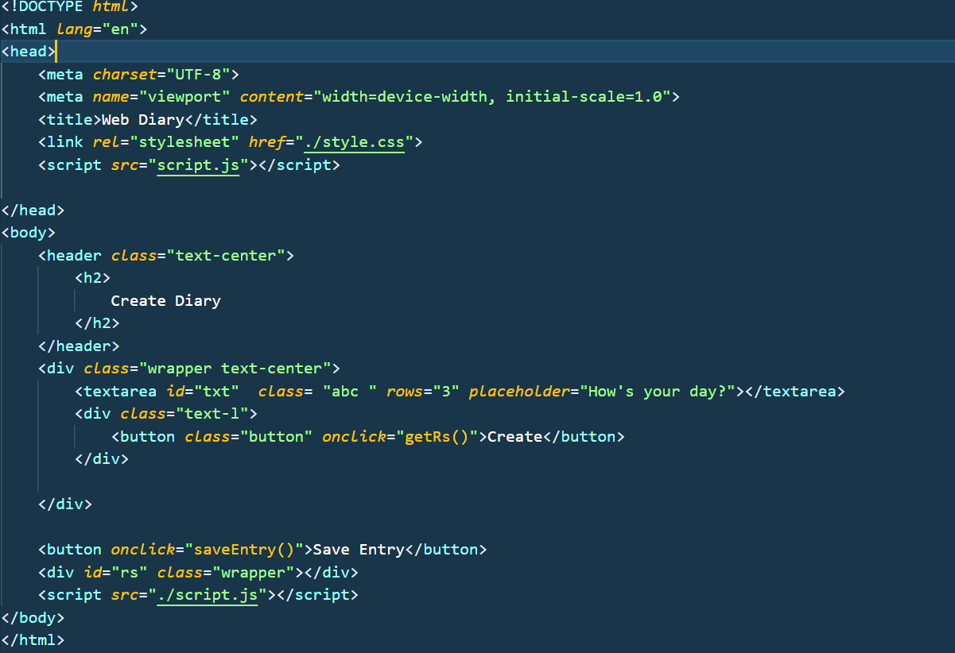
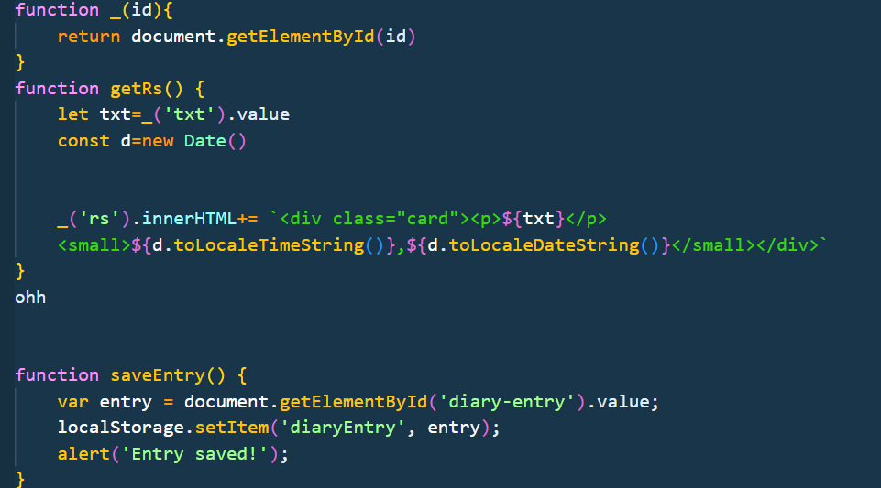
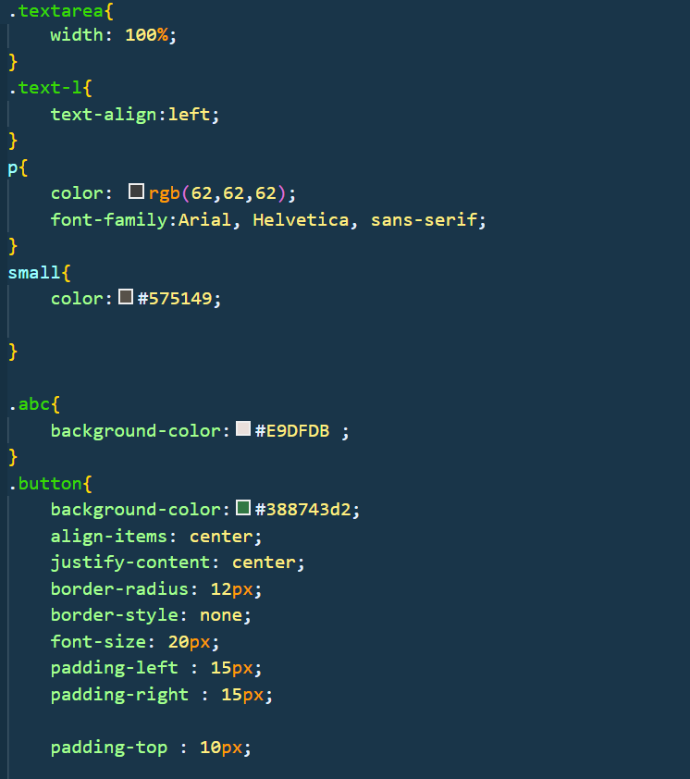
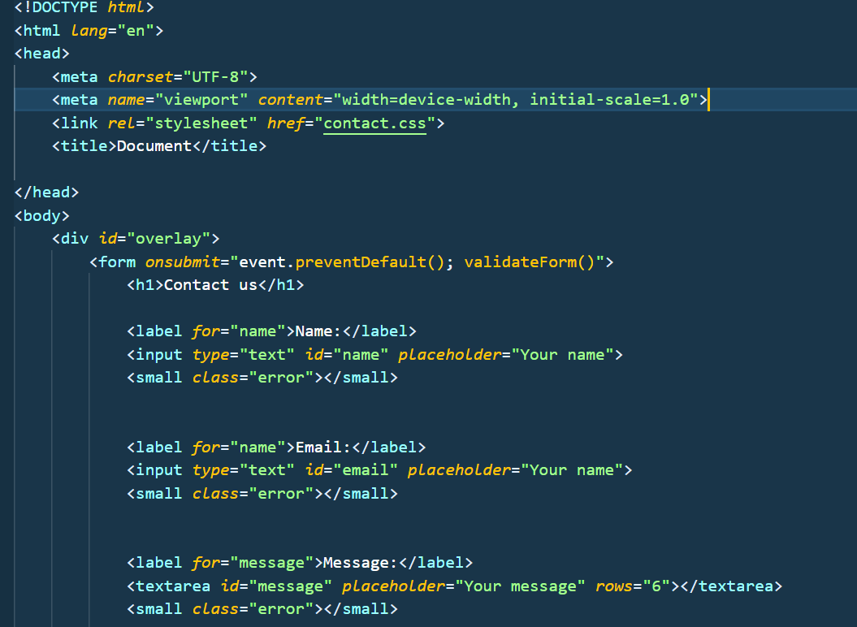
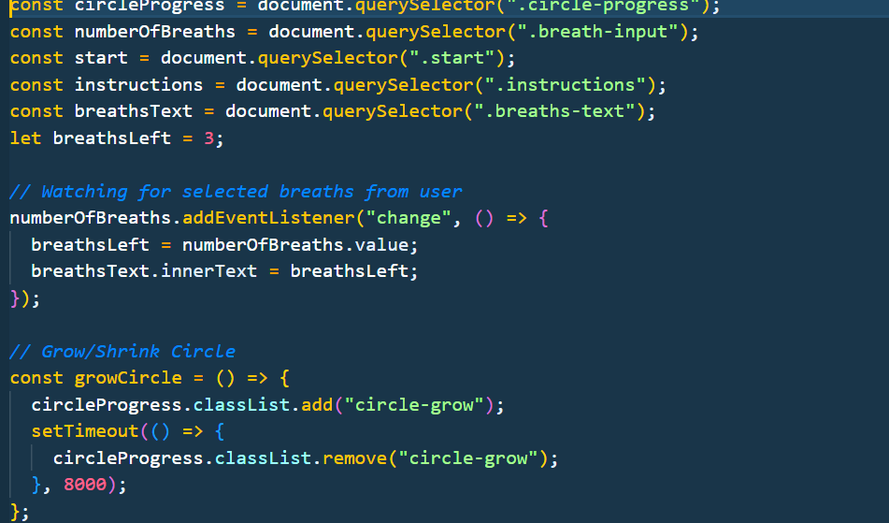
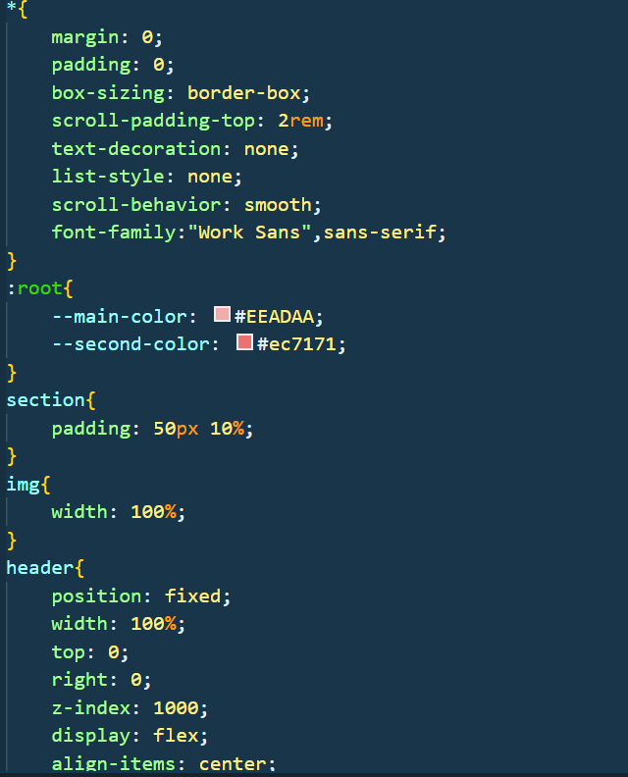
Code Snapshots

Slide 12
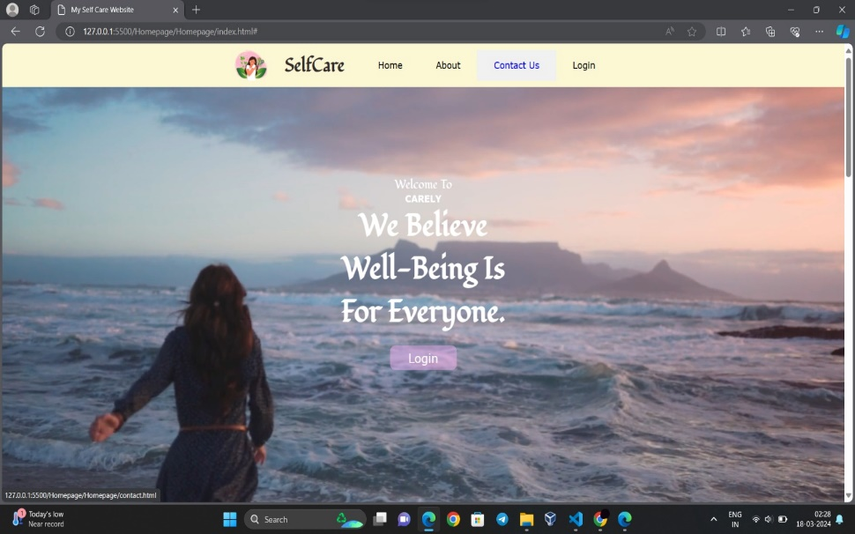
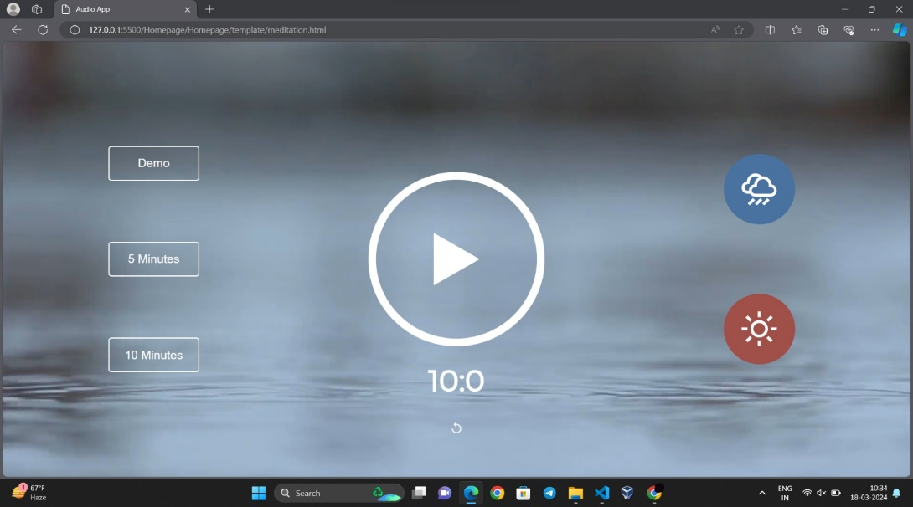
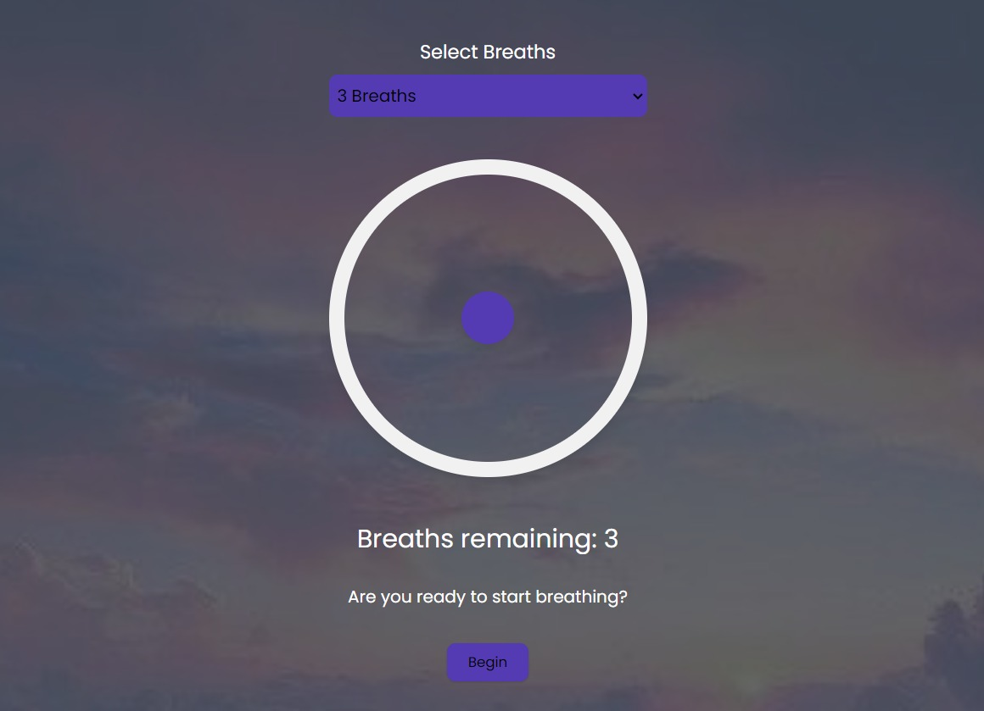
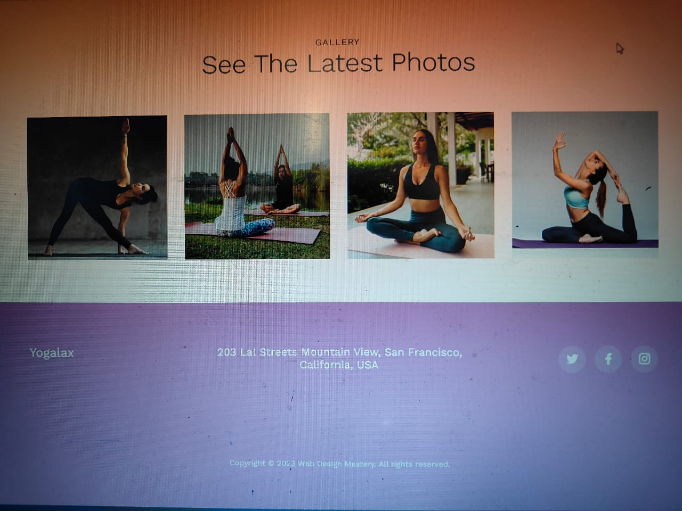
Result

Slide 13
Conclusion
In conclusion, self-care is not just a buzzword or a fleeting trend—it's a fundamental aspect of living a balanced, fulfilling life.
We've learned that self-care isn't selfish; it's an essential investment in ourselves that enables us to show up as our best selves in all areas of our lives.
Remember, self-care looks different for everyone, and it's important to find what works best for you. Whether it's taking a walk in nature, practicing mindfulness, or simply setting boundaries and saying no when needed, every act of self-care matters.

Slide 14
References
NLM Abstract: https://www.ncbi.nlm.nih.gov/pmc/articles/PMC8488814/
Emotional Support: (https://www.psychologytoday.com/us/blog/click-here-happiness/201812/self-care-12-ways-take-better-care-yourself)
Calm mind: (https://www.mindful.org/3-practices-to-connect-with-nature-and-your-inner-wilderness/)
Motivation: (https://www.youtube.com/user/TEDtalksDirector)
Anxiety: (https://www.youtube.com/user/Healing9to5)
Research Paper: Authors: Dorothea E. D. Orem, Susana P. Bunkers, Marcia Riehl, Martha Zuraik
Journal: Nursing Forum
Year: 2001

Slide 15

.

